Slide 1
Project Presentation-RARITONE
Akshith Kalvakota
akshithkalvakota123@gmail.com
AI/ML Intern

Slide 2
OBJECTIVE
Research and implement features of a virtual try on app. Everyday we were given one feature to research about do we could understand the tools and methods we can use to get the desired output.
The ultimate goal is to allow Virtual Try On for customers to improve shopping experience and reduce product returns.

Slide 3
Research Completed:
Human Parsing / Segmentation
Pose Estimation
Body Landmark Detection
Body Measurement Extraction
Garment Warping Techniques
Virtual Try-On Architectures
Recommendation Systems

Slide 4
The models I explored were:
MODEL | PURPOSE
Mediapipe Pose | Body landmark detection
OpenPose | Human pose estimation
CP-VTON | 2D virtual try-on
VITON-HD | High resolution try-on
Stable Diffusion Based Models | Advanced Image Generation

Slide 5
DATASETS COLLECTED:
I collected various datasets to work on, for improving landmark detection , body measurement estimation and to build a recommendation system. Datasets I collected are:
DeepFashion -- Clothing images
DeepFashion2 -- Detection and landmarks
VITON Dataset – Virtual Try-on
Fashionpedia -- Fashion Attributes

Slide 6
Pose Detection:
I used MediaPipe and OpenCV to achieve Landmark Detection. It detected 33 body landmarks at points like shoulders, elbows, wrists, Hips, Knees and Ankles.
It takes Shoulder width, Body height, and waist width to estimate the body pose
Models used were: Mediapipe Pose and OpenPose.
Works better when in Better lighting, Entire body is in camera, and correct distance from Camera i.e Not too far or too close.

Slide 7
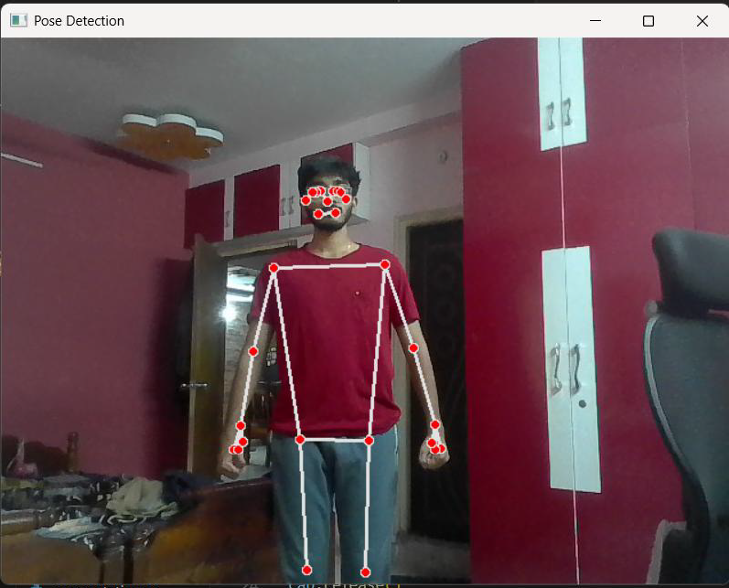
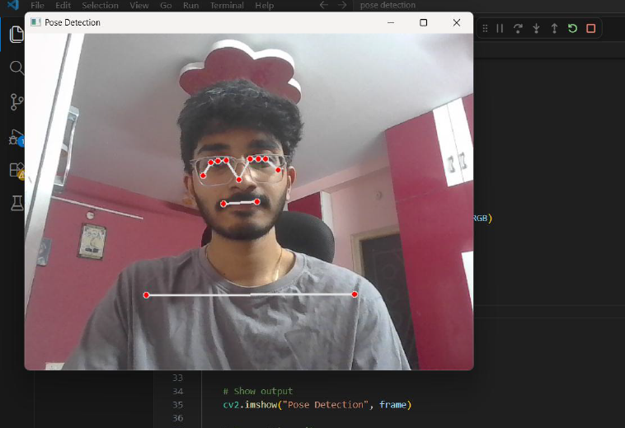
POSE DETECTION

Slide 8
Body Measurement Estimation:
The body measurement is calculated by measuring the distance between Different sets of landmarks with the help of Euclidean distance formula.
For more accurate, the model should be trained with real life objects and their real measurements should be provided. So keeping them as reference, it gives better body measurements.
Landmark-based estimation provides useful approximations but cannot fully replace physical measurements. Its not exactly accurate but It is important to suggest correct sizes for the customers.

Slide 9
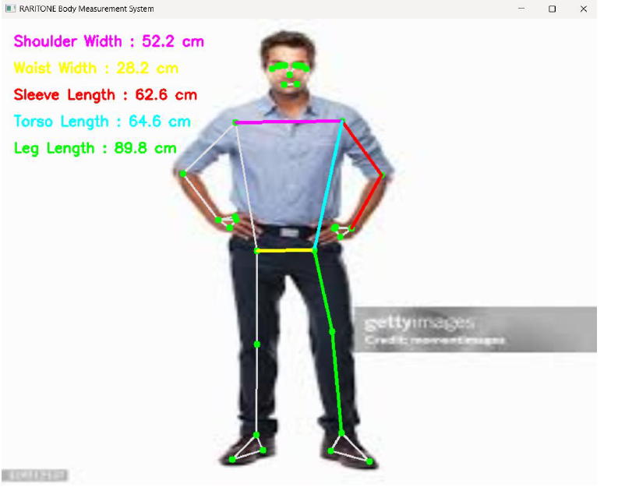
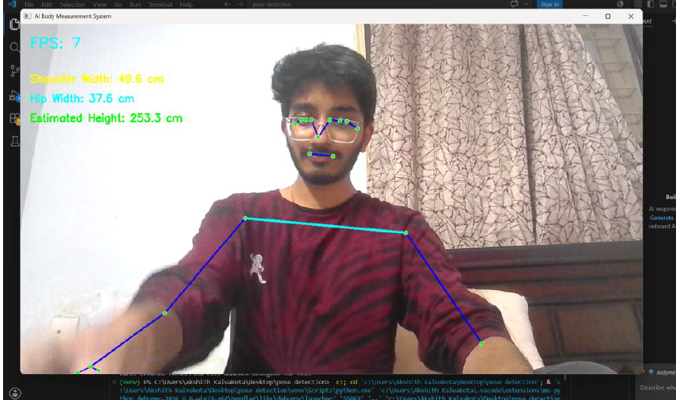
BODY MEASUREMENT

Slide 10
Human Parsing and Segmentation
Segmentation separates the person from the background and identifies different body regions. It helps by:
Remove background noise
Detect body shape
Improve garment alignment
Increase virtual try-on accuracy
Used MediaPipe Selfie Segmentation (pre-trained deep learning segmentation model) provided by MediaPipe. and OpenCV

Slide 11
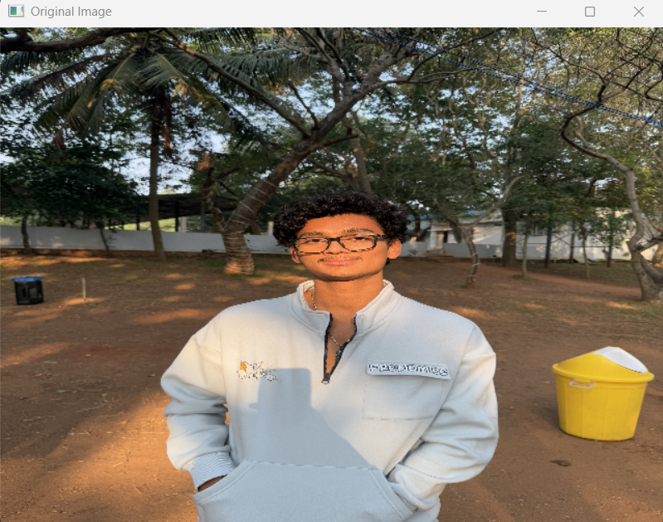
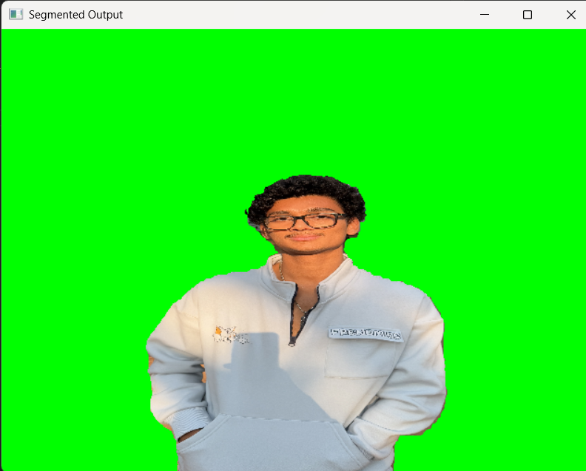
SEGMENTATION ATTEMPT

Slide 12
3D modelling :
3D virtual try-on creates a three-dimensional body representation and simulates clothing fitting.
I used Trimesh to load and manipulate 3D models and Pyrender for rendering and visualizing 3D models.
I downloaded .obj files of a human body and a clothing to try to person a 3D VTON. But I couldn’t do it correctly.
Applied transformations such as:
Translation (move jacket)
Scaling (resize jacket)
Rotation (align jacket)

Slide 13
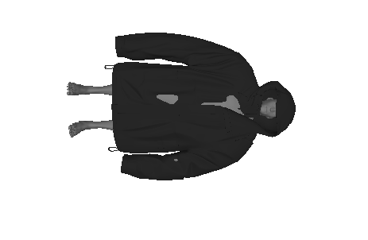
BODY MODEL ATTEMPT

Slide 14
AI Recommendation System
A recommendation system can improve user experience.
I took different so we could recommend Sizes, Brands, and Specific outfits based on the user’s interest by tracking his/her shopping behaviour.
We use Python Pandas library to access the datasets and get only desired records from it to show to the user based on what to recommend them.

Slide 15
CHALLENGES FACED:
Working with 3D Models
Aligning jacket.obj with person.obj was not straightforward.
Differences in model scale, position, and orientation caused fitting issues.
Solution: Used Trimesh and Pyrender to visualize and manually adjust mesh placement
Limited Computing Resources
Many state-of-the-art virtual try-on models require GPUs and large amounts of memory.
Running full-scale training was not feasible.
Solution: Focused on research, workflow design, lightweight implementations, and model analysis.

Slide 16
Body Measurement Accuracy
Estimating real-world measurements from a single image is difficult.
Measurements vary based on camera angle, distance, posture, and image quality.
Solution: Used landmark-based approaches with MediaPipe and focused on relative measurements rather than exact physical measurements.
Environment Setup & Dependency Management
Setting up the virtual environment and managing library dependencies caused issues due to package version conflicts and installation errors.
Solution: Created isolated Python virtual environments (venv) and configured the development environment properly in VS Code. And understood that most AI tools still only work in Python 3.11 versions.

Slide 17
COMPLETE AI WORKFLOW
Final Visualization
User Uploads Image
Body Measurement Estimation
Pose Detection
Recommendation Engine
Image Preprocessing
Garment Processing
Human Segmentation
Virtual Try-On Generation

Slide 18
SKILLS I ACQUIRED THROUGH THIS INTERNSHIP:
Professional Skills
Technical Skills
Computer Vision
Machine Learning Research
Dataset Analysis
MediaPipe
Pose Estimation
AI Workflow Design
Documentation
Research Analysis
Problem Solving
Technical Reporting

Slide 19
CONCLUSION
During this internship, extensive research was conducted on AI-powered virtual clothing try-on systems.
Key outcomes:
Studied multiple AI models
Explored public datasets
Investigated 2D and 3D try-on techniques
Designed a complete workflow
Proposed recommendation system ideas
The internship provided valuable exposure to real-world applications of Artificial Intelligence, Computer Vision, and Machine Learning in the fashion technology domain.

Slide 20
THANK YOU
For providing this internship opportunity, it helped me a lot in understanding new concepts like Computer Vision and VTON systems which helps me move forward towards hopefully a successful career.

